Slide 1


Graduated Thesis
A middleware framework to
support scientific generation using an AI approach
Presenter: | BA11-007 Nguyễn Tuấn Anh
Supervisor: | MSc. Lê Như Chu Hiệp
July, 2025

Slide 2
Table of Content
01.
INTRODUCTION
Problem Statement
Proposal System
Objectives and Scope
02.
REQUIREMENT ANALYSIS
Requirement
System Functionalities
03.
SYSTEM DESIGN
Overview Pipeline
System Architecture
System Implementation
Backend Processing
04.
RESULTS &
DISCUSSIONS
05.
CONCLUSIONS &
FUTURE WORKS

Slide 3
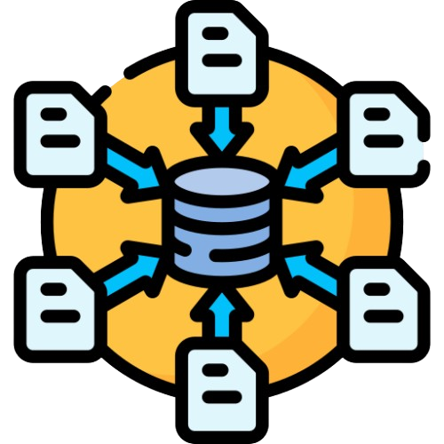

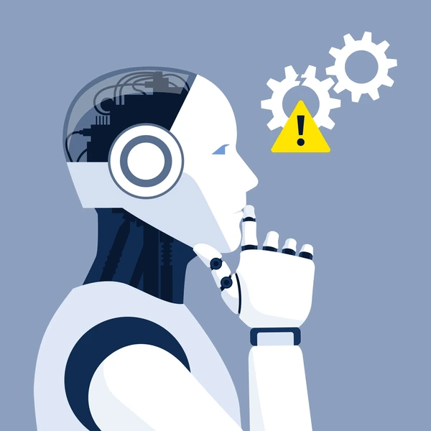

01.
INTRODUCTION
Problem Statement:
What problems exist when users use AI to learn, search and visualize scientific content?
Search tool usability
AI LaTeX/TikZ output
Create good AI questions
?
Aggregation information
Return text-based form
AI is confusing
Received information
interactive ability
Must compile manually
hard for student studying
Hard for user not familiar
Proposal System
Spend time to
read, understand
01

Slide 4






01.
INTRODUCTION
Proposal System:
AI PELaX = Artificial Intelligence for Processing and Exploring LaTeX
What it can do?
Middleware
Allow users send questions to AI
Show AI response with diagrams/formulas directly.
What its benefits?
Supports learning, writing scientific documents... faster & easier
02

Slide 5




01.
INTRODUCTION
Objectives and Scope:
Create a mobile application & middleware with scientific content generated by AI
Objectives
Scopes
Help users create better questions
Mobile devices (Android) using
Flutter framework
Support different AI models
LaTeX/TikZ diagrams/maths content
generated by AI
Make it easier for students to
use AI in learning
UI design for ease of use
(especially TikZ/LaTeX)
03

Slide 6
02.
REQUIREMENT ANALYSIS
Requirement:
01
02
System Requirement
Non-Functional Requirement
Core Function:
Flutter-based app displays results directly on Android devices.
Automatically identifying & extracting LaTeX/TikZ code
Displaying results directly inside application
Rendering LaTeX/TikZ code into images through middleware Flask backend
Performance: System respond & render images quickly.
Scalability: System work with different AI models via APIs.
User-friendliness: UI is simple & easy use (people no LaTeX background).
Offline support: App allows access saved content even when no internet connection.
Privacy and security: User data are safe & not shared without permission.
04

Slide 7
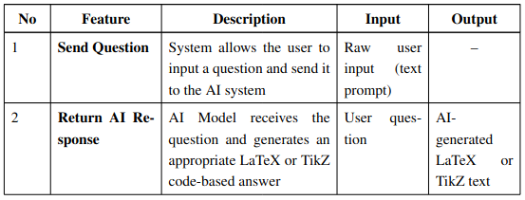
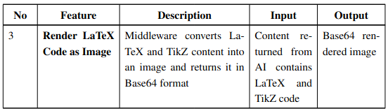
02.
REQUIREMENT ANALYSIS
System Functionalities:
Table: Overview of System Functionalities
What do we get from the table?
3 main features
Send Question ---> Flutter UI
Return AI Response ---> AI Model
Render LaTeX Code as Image ---> Flask Middleware
Overview Pipeline
05

Slide 8
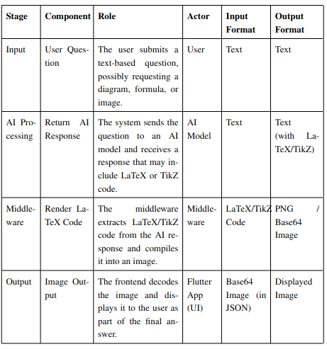
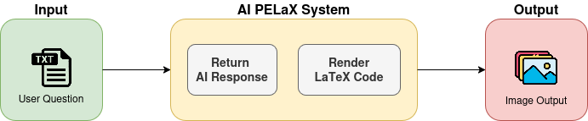
03.
SYSTEM DESIGN
Overview Pipeline:
Table: Overview of System Functionalities
Figure: AIPELaX System Pipeline Overview
06

Slide 9
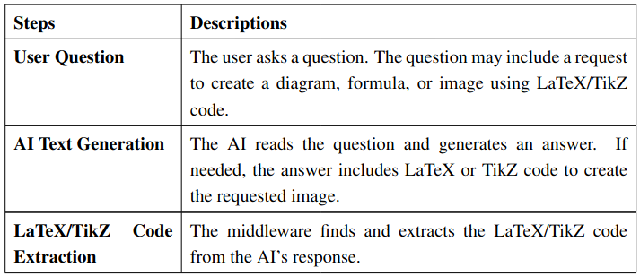
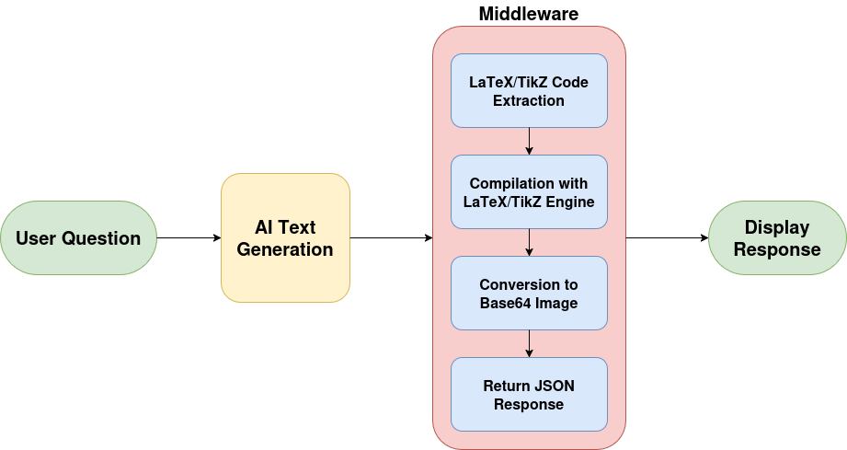
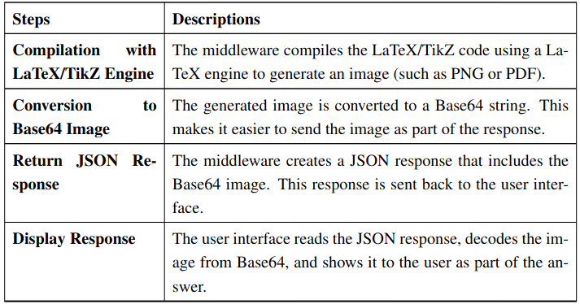
03.
SYSTEM DESIGN
System Architecture:
Table: AI PELaX Pipeline: Step-by-Step Description
Figure: AIPELaX System Architecture
07

Slide 10
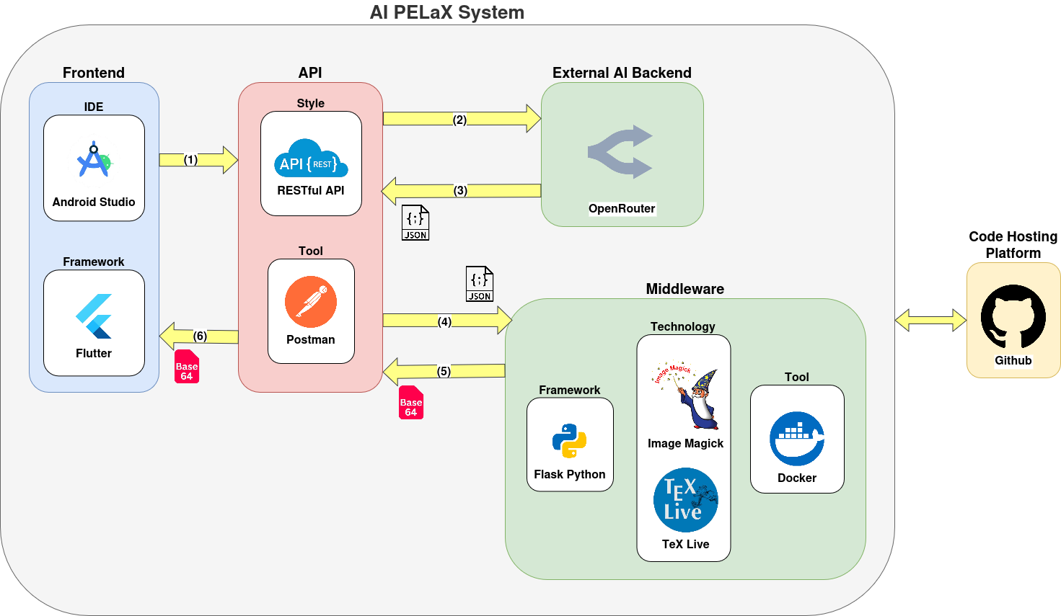
03.
SYSTEM DESIGN
System Implementation:
Figure: AIPELaX System Implementation
08

Slide 11
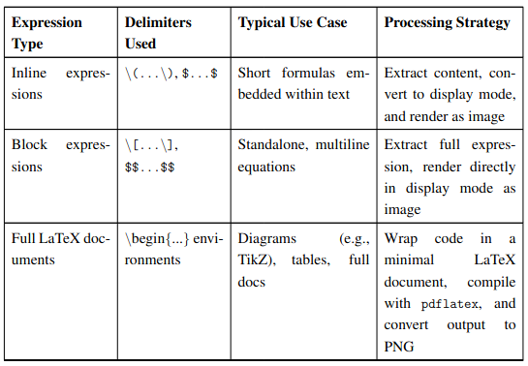
03.
SYSTEM DESIGN
Backend Processing:
Step 01
Survey AI Response Patterns
Step 02
Backend Implementation
01
02
03
Used Model: DeepSeek Open-R1
Backend Architecture
Parsing and Extraction Logic
Docker Packaging
Table: LaTeX Expression Types and Processing Strategies
Framework
Python Flask
Goal: clean debugging, maintainable backend structure
Input formats: inline, block, full docs, markdown-style LaTeX
Main file: app.py – handles parsing & routing logic
Renderer file: latex_renderer.py – LaTeX → PNG (base64)
Function: render() – cleans, detects formats, delegates rendering
Function: parse_inline_latex() – extracts inline math patterns
Steps: UUID → .tex → .pdf → .png → base64 string
Error handling: returns plain text if LaTeX fails
File structure: organized into outputs/tex, pdf, aux, logs, png
Goal
One-command launch & Saved Code
API Endpoint
POST /render_latex
Tool: Docker – bundles LaTeX, Python, ImageMagick
Structure
app.py
latex_renderer.py
09

Slide 12
04.
RESULTS & DISCUSSIONS
Results:
Results
Challenges and Limitations
[=
Full Integration
Flutter App, AI Model & Middleware
LaTeX Rendering Errors
Flutter UI Limitations
Accurately Rendered LaTeX Code into Images
Slow Response Time
Flutter App Receives & Displays Responses Smoothly
Model Inaccuracy
Comprehensive Testing & Debugging
Data Loss on Restart
10

Slide 13
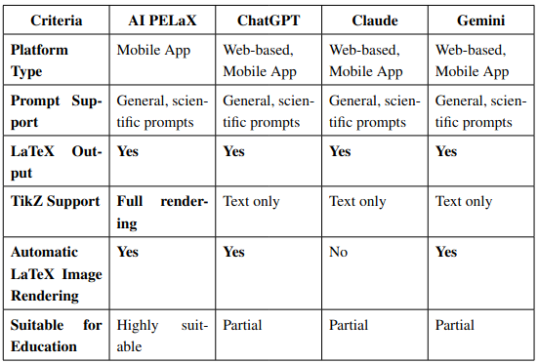
04.
RESULTS & DISCUSSIONS
Discussions:
Table: Comparision with other systems
What can our system do?
What criteria our system better?
11

Slide 14


05.
CONCLUSIONS & FUTURE WORKS
Conclusions:
Practical Problem
Based-text format AI generates scientific content (LaTeX, TikZ)
→ Difficult viewing without technical expertise.
Proposal System
Develop middleware system between AI & App
→ Automatically extract & visualize TikZ content.
Advantages
User-friendly interface
Fast & secure processing
Can run directly without 3rd platforms
Practical Significance
Education, Learning, Modern Scientific Researching
Serves as foundation for future deeper integration AI & scientific visualization
12

Slide 15






05.
CONCLUSIONS & FUTURE WORKS
Future Works:
01
02
03
04
05
Cross-platform & multilingual support
User questions & response history
Interactive LaTeX/TikZ editing
Smart caching mechanism
Toward smarter scientific tools
13

Slide 16
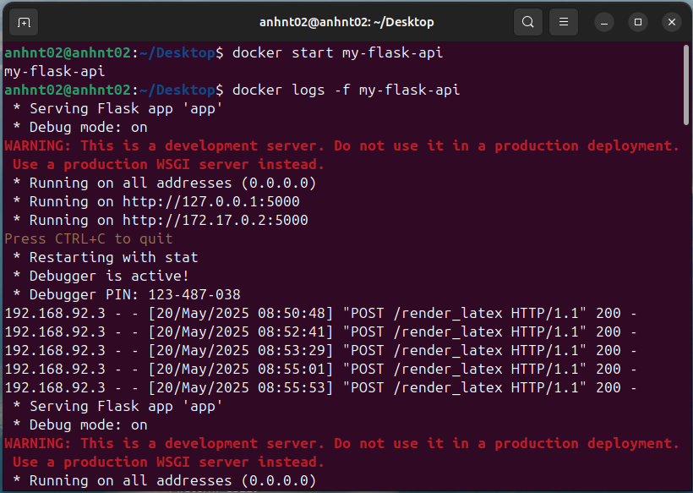
Demo
Figure: Docker Backend Deploy Running
Demo
Rendering
Successful!

Slide 17

Thank you for listening!
Do you have any questions?

Slide 18

QnA
What our system have NOT done yet with Objective?
Due to spend lot of times.
Research: Fine-tuning an AI Model + Few-shot learning method or Chain-of-Though,.....
But: Now, system still good! At least to solve some Math Exercise!

Slide 19
QnA
Why use DeepSeek Open-R1?
Due to: Random choice, Free API
When I survey the AI response of many model, each of the model is quite good for rendering LaTex/TikZ code => If I use another model, could be the same!

Slide 20
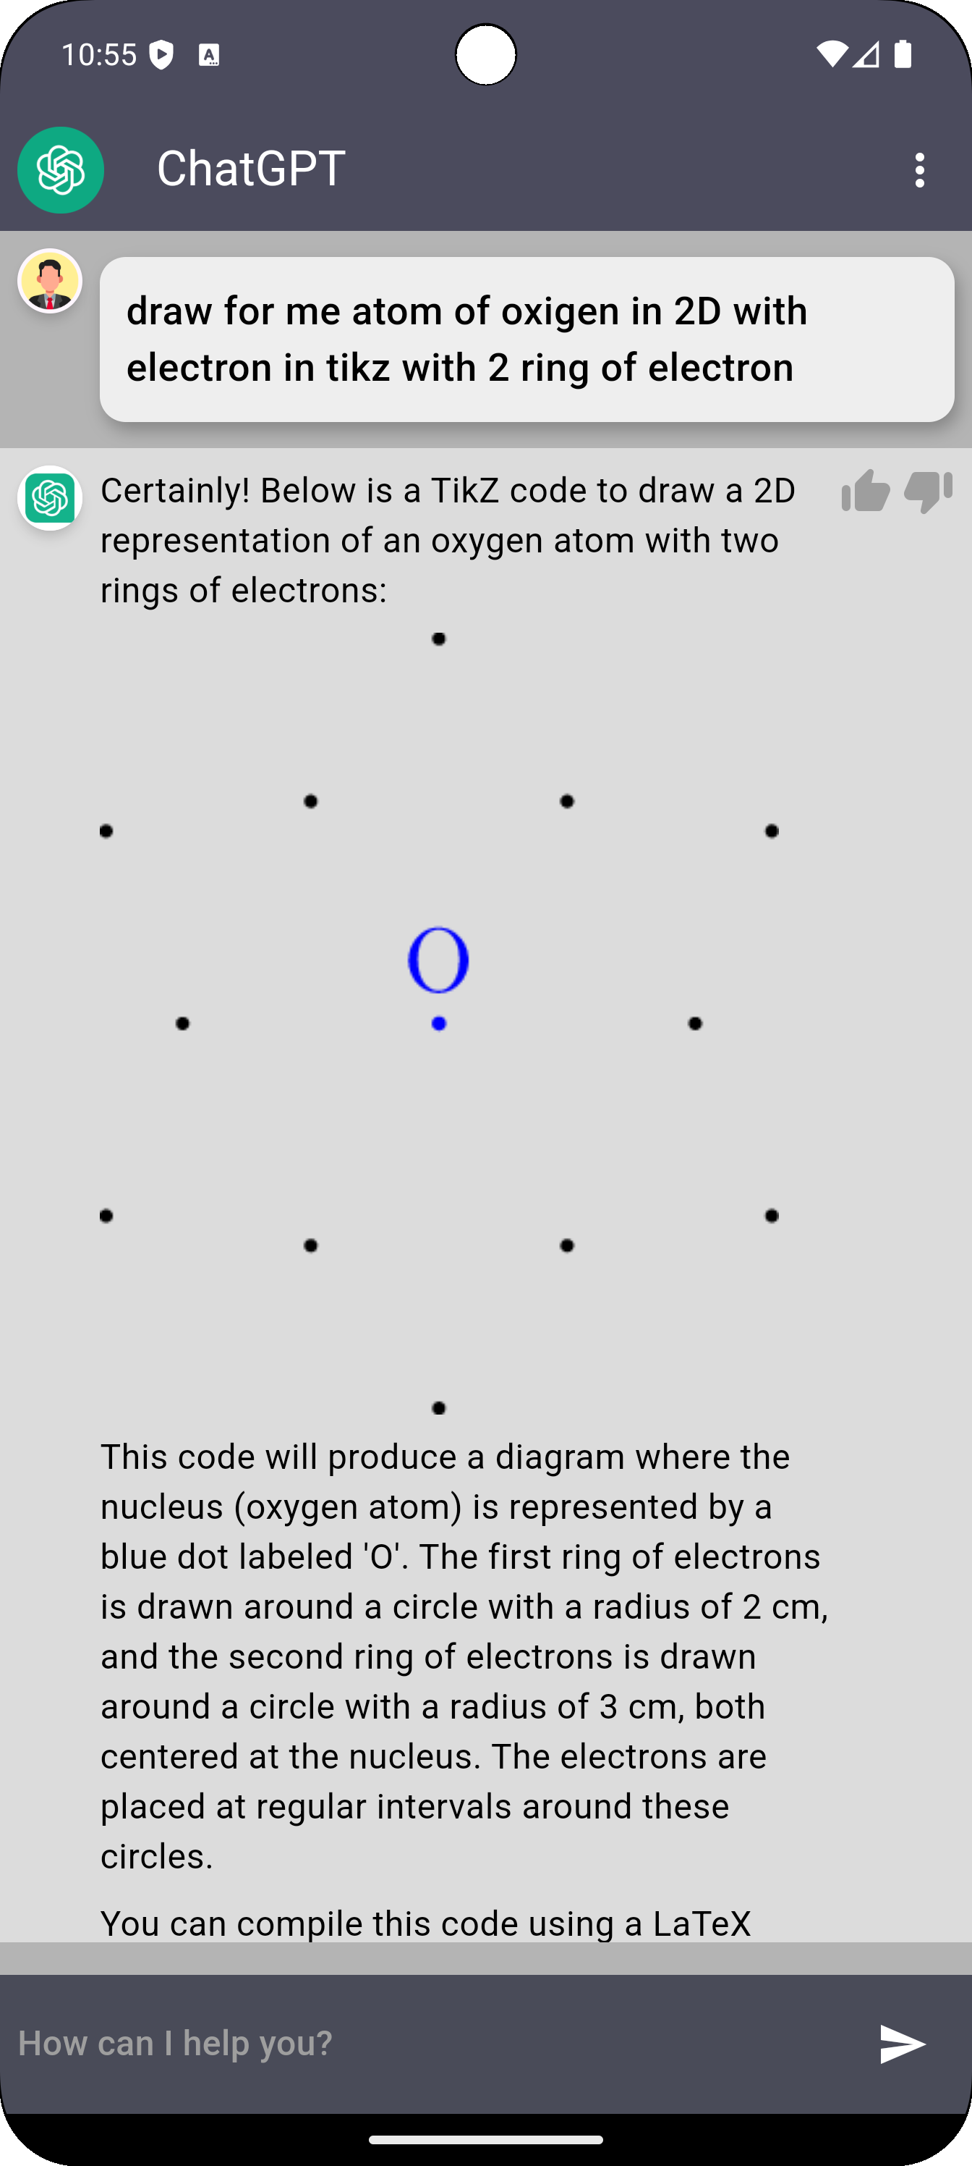
QnA
What happen when apply system to real life?
- Some complex expressions are difficult to parse or wrong model return.
- Slow response on weak devices/weak internet.

Slide 21
QnA
How to improve time spending problem?
Use lightweight models: Implement models like DistilBERT or Gemini Nano for faster inference.
Caching method: Store results of frequently used expressions to avoid redundant processing.

Slide 22
QnA
What happen if we ask another type of question (not only math but also in Chemistry, Physics,...)?
Can system have the same performance?
Now: just good in math => Then: update survey LaTex/TikZ with more subjects.

